Slide 1

Operating Systems
Lecture by
Engr Fatima Jaffar

Slide 2
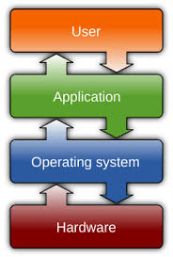
Introduction to Operating Systems
Definition and Purpose:
At its core, an operating system (OS) serves as an intermediary between users and computer hardware, managing resources and facilitating user commands through simplified abstractions of hardware functionalities.

Slide 3
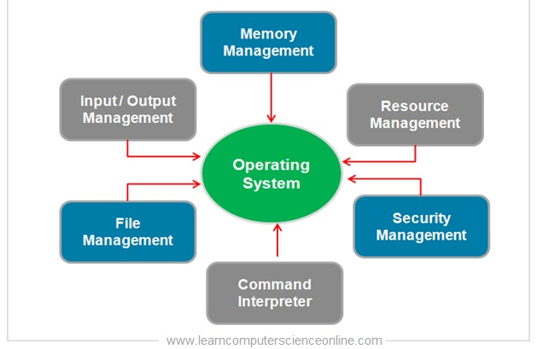
Importance of Operating Systems
Efficient Resource management

Slide 4
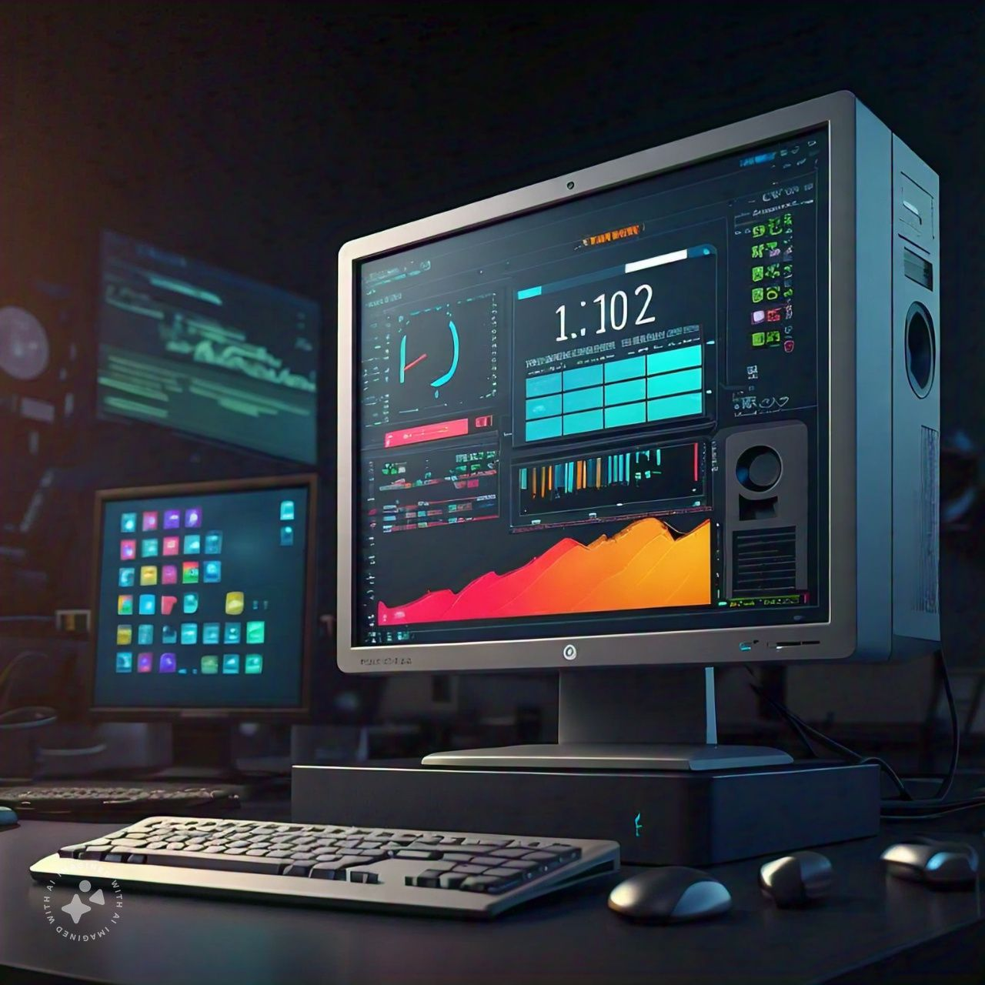
Importance of Operating Systems
Efficient Resource management
System Stability

Slide 5
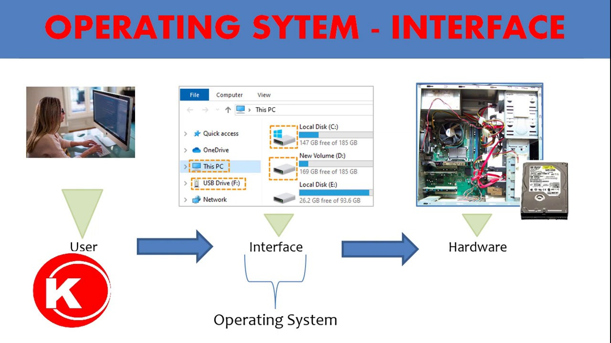
Importance of Operating Systems
Efficient Resource management
System Stability
Provides interface to user to interact

Slide 6
Types of Operating Systems
1. Batch Operating Systems
Batch 1
User 1-job 1
CPU
Job 1
Job-3
Job 10
User 2-job 2
Operator
User 3-job 3
Batch 2
Job 1
Job-3
Job 10
User n-job n

Slide 7
Types of Operating Systems
1. Batch Operating Systems
Batch 1
User 1-job 1
CPU
Job 1
Job-3
Job 10
User 2-job 2
Operator
User 3-job 3
Batch 2
Job 1
Job-3
Job 10
User n-job n

Slide 8
Types of Operating Systems
2. Multiprogram operating System
Job 2
I/O?
I/O?
Job 1
Job 3
I/O?
CPU
Notes:
Windows
MacOS

Slide 9
Types of Operating Systems
Multiprocessing operating System
Job 1
Job 1
CPU 2
Job 2
Main Memory
Job 2
CPU 1
Notes:
Servers

Slide 10
Types of Operating SYstems
Distributed Operating Systems
Terminal
Terminal
CPU
Terminal
Terminal
Terminal
Notes:
Jobs will be distributed through out the network

Slide 11
Types of Operating SYstems
Time Sharing Operating Systems
Process 1
5ms
CPU
Process 2
4ms
Process 3
3ms
Notes:
Windows
Linux
MacOS

Slide 12
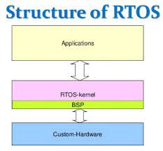
Types of Operating Systems
Real-time operating Systems
Notes:
Process should be executed with in the time limit

Slide 13
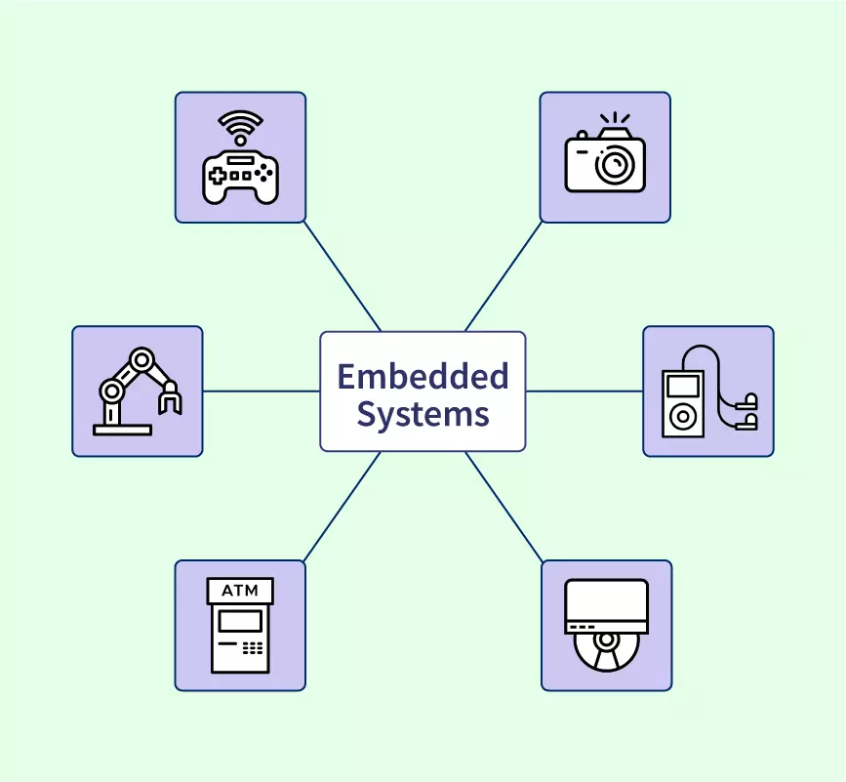
Types of Operating Systems
Embedded operating system
Notes:
As we delve into the various types of operating systems, it's critical to understand their architectures and intended applications. For example, batch operating systems optimize resource use by processing jobs in groups but face challenges in interactivity. On the other hand, time-sharing systems strive to enhance user experience by allowing simultaneous interactions with a shared computational resource. Furthermore, the capabilities of distributed operating systems to present a unified front of multiple independent machines underline their strength in resource sharing and fault tolerance. Real-time operating systems bring forth a different design philosophy, emphasizing timing accuracy for critical applications, while embedded systems demonstrate the adaptation of OS concepts to specific tasks in consumer products.

Slide 14
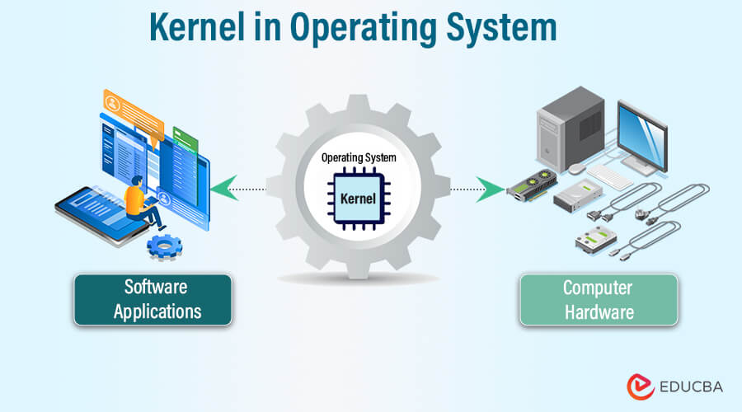
Operating System Components- Kernel
Core component
Intermediary between hardware and software
Handles system calls
Manages processes
Memory management
File system management
Device management
Notes:
. The kernel, as the heart of the OS, is responsible for direct hardware interactions and process management, governing pivotal functions that affect all operations..

Slide 15
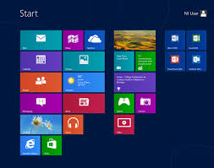
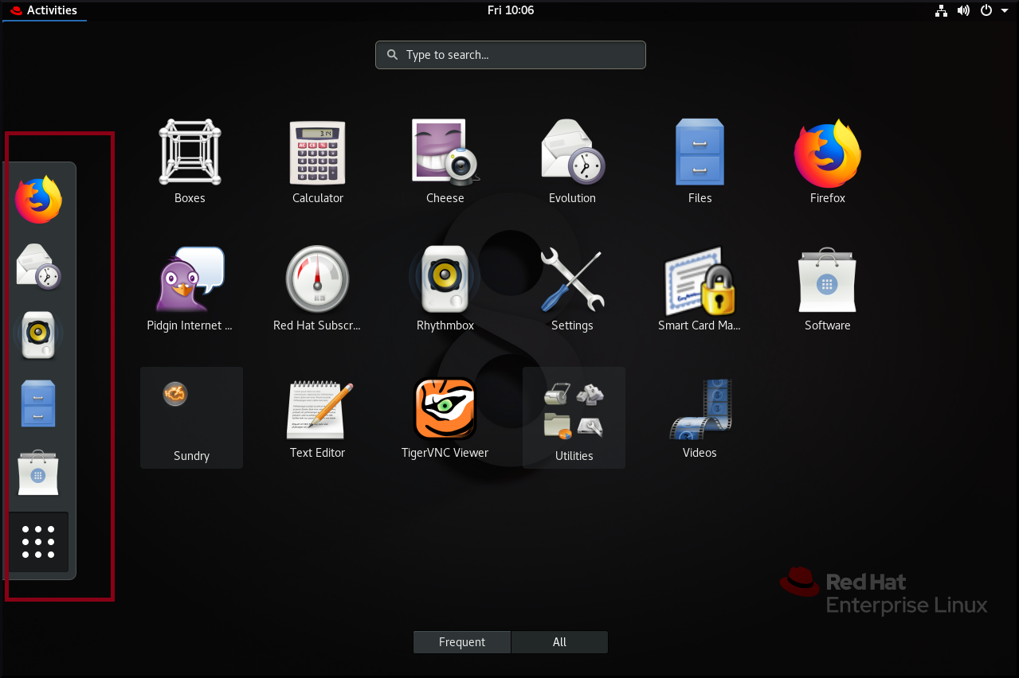
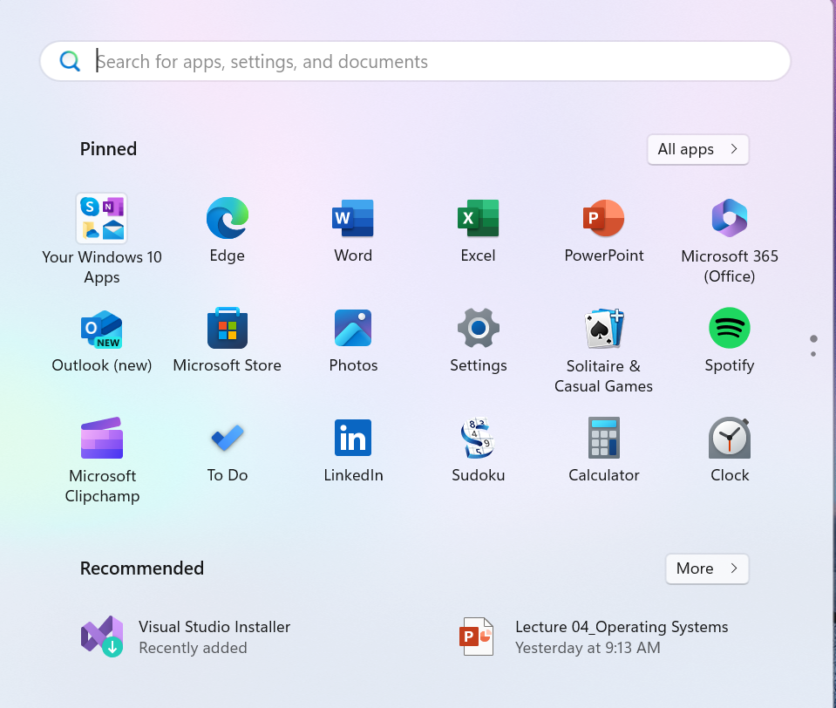
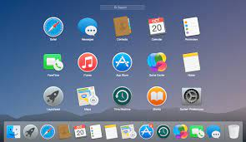
Operating System Components-UI
Notes:
Coupled with the user interface, which dictates the ease of interaction between users and the system, these components work together to improve usability

Slide 16
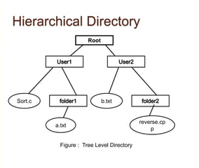
Operating System Components-File System
Notes:
Additionally, the file system's structured approach to data storage and retrieval is crucial for maintaining data integrity and accessibility.

Slide 17
Operating System Components-File Management System
Manages files and directories
Stores metadata about files (name, size, type, creation date, etc.)
Organizes files into hierarchical structures (directories)
Implements access control mechanisms to protect files from unauthorized access
Handles file allocation and deallocation
Supports various file systems (e.g., FAT, NTFS, ext2, ext3, ext4)
Provides mechanisms for backing up and restoring files

Slide 18
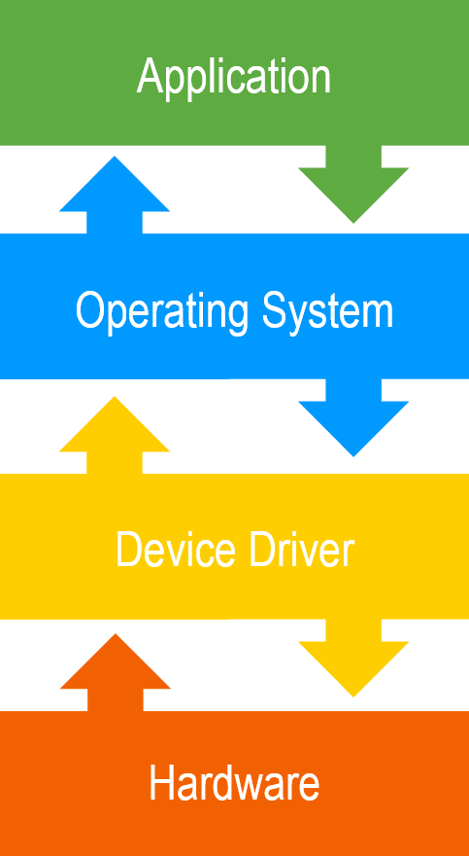
Operating System Components-Device Drivers
Interface between hardware and software
Standardized communication
Handle device-specific operations
Included with devices or provided by OS
Essential for system performance and stability
Notes:
Device drivers act as the vital link between the operating system and hardware, ensuring commands are effectively translated and executed

Slide 19
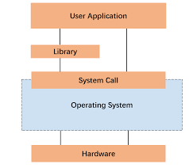
Operating System Components-System Libraries
Pre-written code modules
Provide common functionalities
Reusable across applications
Examples:
Graphical user interface (GUI) libraries
Input/output libraries
Networking libraries
Mathematical libraries
Database libraries
Notes:
, whereas system libraries enhance programming efficiency by providing prebuilt functionalities.

Slide 20
Operating Systems-Process Management
Process??
A program in execution

Slide 21
Operating Systems-Process Management
Process States:
Ready
Running
Waiting
Terminated
Scheduling
Context Switching

Slide 22
Operating Systems-Process Management
RAM Allocation
Paging
Segmentation
Virtual Memory

Slide 23
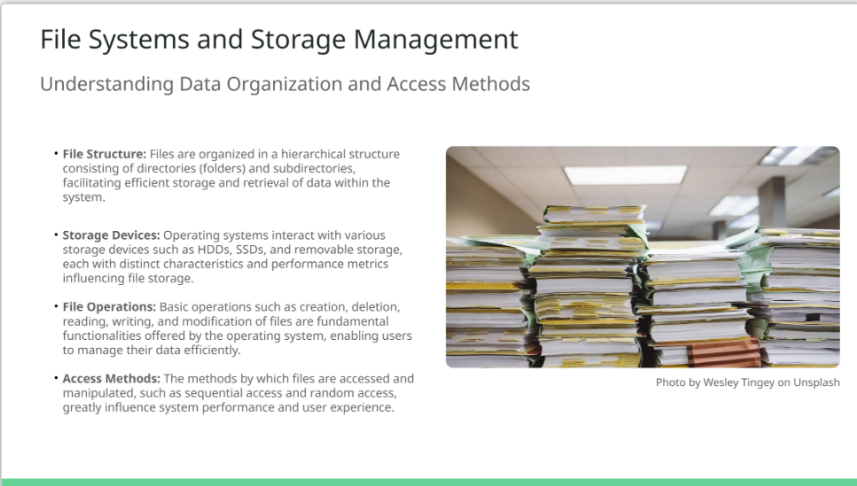
Notes:
The management of files and storage is a critical aspect of operating systems that defines how data is organized and manipulated. The hierarchical arrangement of files and directories not only streamlines data management but also enhances user navigation. Various storage devices available to operating systems present different attributes that can influence performance and accessibility. Offering a suite of file operations, the OS empowers users to effectively manipulate their data. Furthermore, the chosen access methods can substantially affect system throughput and overall performance, with sequential processes suited for certain applications while random access provides versatility and speed.

Slide 24
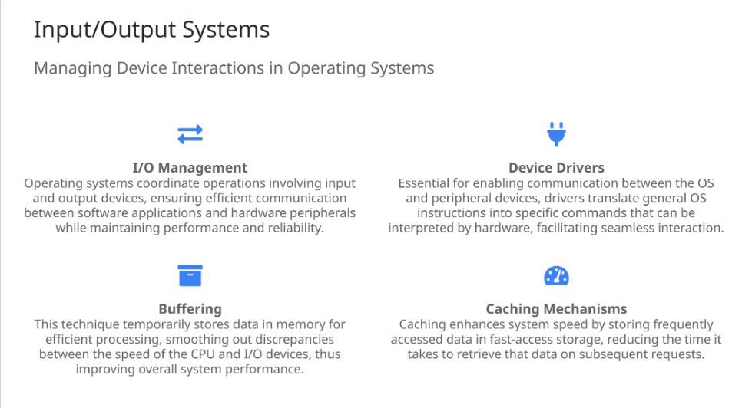
Notes:
The management of input/output systems is critical to ensuring harmonious interaction between software and hardware. The OS plays a pivotal role in managing the I/O flow, ensuring that operations involving peripherals do not bottleneck overall system performance. Device drivers are fundamental in translating between the OS's generic commands and the specific instructions required by hardware devices. Buffering acts as a critical intermediary that aligns processing speeds, allowing the CPU and I/O devices to function effectively together. Meanwhile, caching optimizes performance by reducing retrieval times for frequently used data, increasing responsiveness and efficiency in operations.

Slide 25
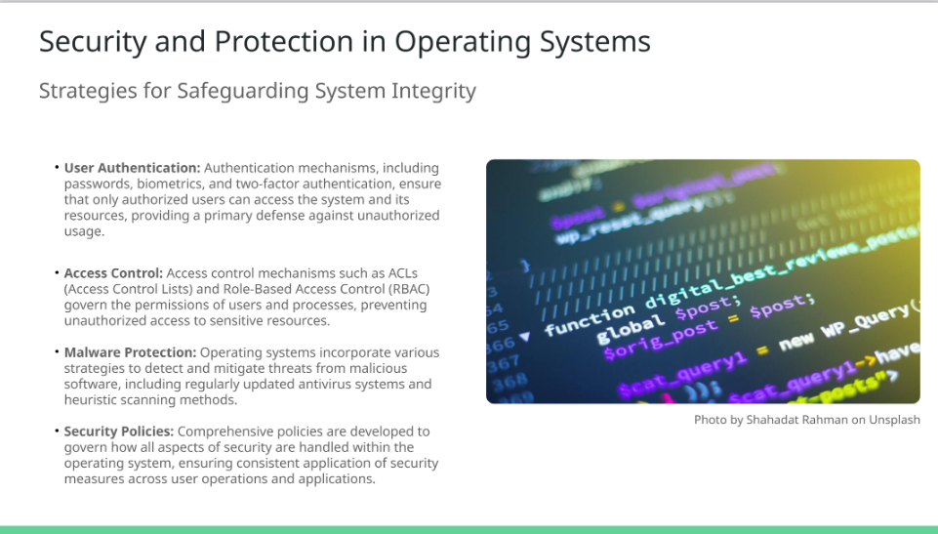
Notes:
In an era where data breaches and cyber threats are rampant, security and protection mechanisms within operating systems have never been more crucial. User authentication serves as the first line of defense against unauthorized access, utilizing various technologies to confirm user identity. Furthermore, access control measures ensure that users are granted permissions commensurate with their roles, bolstering the protection of sensitive resources. Operating systems also employ robust malware protection strategies to fend off malicious software, with continuous updates to safeguard systems against emerging threats. The establishment of security policies further reinforces these measures, facilitating a structured approach to maintaining a safe computing environment.

Slide 26
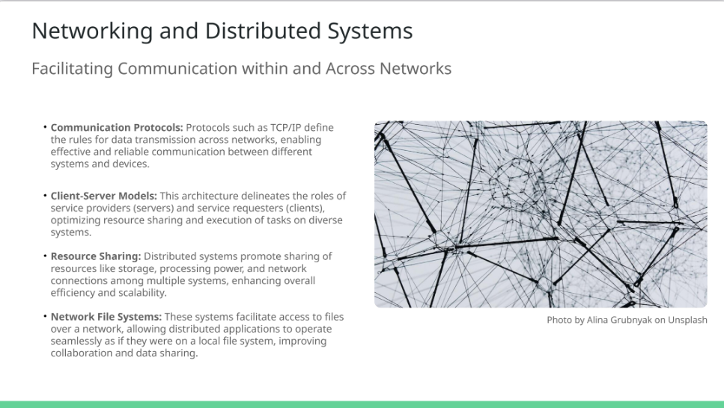
Notes:
The role of networking in operating systems is essential for enabling communication across various devices and facilitating distributed computing. Communication protocols, such as TCP/IP, lay down a foundation for reliable data exchange, ensuring that systems can connect and communicate effectively. The client-server model enhances this dynamically, clearly delineating roles and responsibilities that lead to optimized resource sharing. Distributed computing facilitates collaboration across systems by pooling resources, significantly contributing to overall efficiency. Moreover, network file systems extend the functionality further by providing seamless access to files as if they were located locally, enabling application interoperability and smoother collaboration.

Slide 27
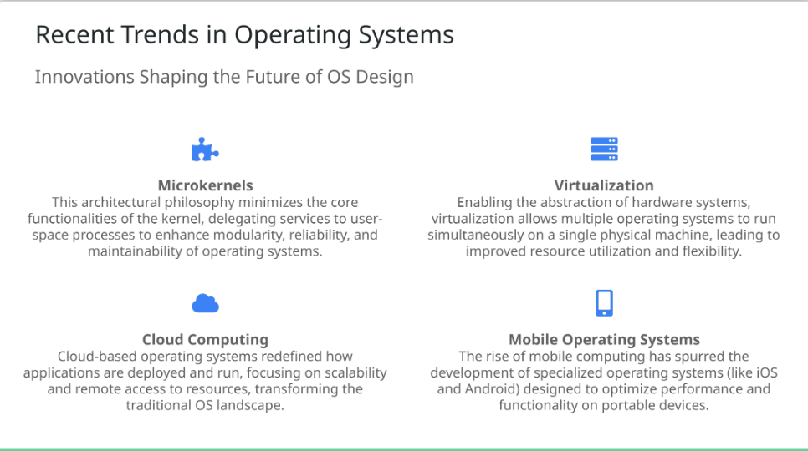
Notes:
The landscape of operating systems continues to evolve rapidly, with recent trends indicating a shift towards enhanced modularity and efficiency. The microkernel architecture presents a paradigmatic shift, refining kernel functionality while offloading services to user-space processes, thereby enhancing system reliability. Virtualization technology has unlocked new possibilities, allowing multiple OS instances to coexist on one hardware platform, thereby maximizing resource efficiency. Cloud computing has revolutionized the deployment of applications and resources, signifying a move towards scalability and accessibility. Concurrently, mobile operating systems are on the rise, addressing the unique computational needs of portable devices and shaping how users interact with technology.

Slide 28
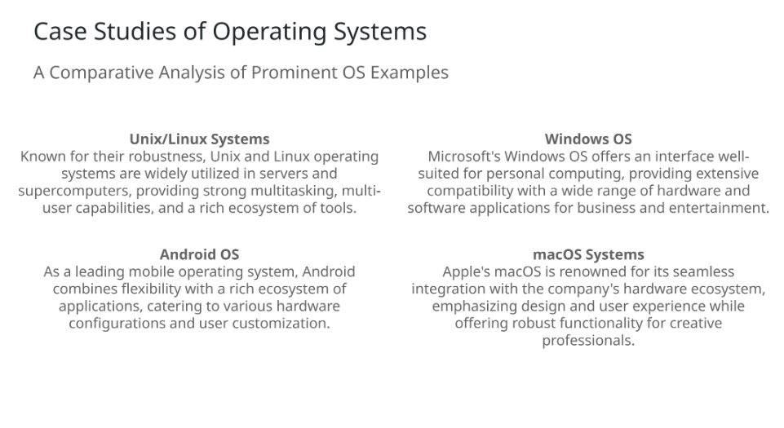
Notes:
Examining case studies of different operating systems unveils their unique competencies and design philosophies. Unix and Linux systems have garnered a reputation for their stability and extensive toolsets, often being the backbone of server infrastructures. In contrast, Windows has dominated personal computing with a user-friendly interface and compatibility across diverse applications. Android leads in the mobile space, promoting user customization while supporting a vast app ecosystem. Meanwhile, macOS exemplifies Apple's approach to design and integration, focusing on delivering a superior user experience for creative tasks. Understanding these examples helps highlight the diverse functionalities and implementations of operating systems in different environments.

